Slide 1

The POTENTIAL Association Between CARDIAC Arrest/MYOCARDIAL INFARCTION and COVID Vaccination
Findings fROM A large 2023 Sample Of US Adults

Slide 2

Agenda
Objective
Background
Hypothesis
Methods
Summary
References

Slide 3
Objective
Cardiac arrest/myocardial infarction is a chronic health condition afflicting many adults in the United States. The objective of this study is to quantify the potential relationship between a diagnosis of the affliction and Covid vaccination, while controlling for one’s exercise activity, biological sex, age category, and race.

Slide 4
BACKGROUND
Cardiac arrest/myocardial infarction
  Relevant Definitions
    Cardiac arrest occurs when the heart suddenly stops beating, leading to a loss of blood flow and oxygen to the body.
    A myocardial infarction (MI), commonly known as a heart attack, occurs when blood flow decreases or stops in one of the coronary arteries of the heart, causing infarction (tissue death) to the heart muscle.
  Seriousness
    Most people who experience cardiac arrest do not survive. Among those who do, there is risk of neurological dysfunction, brain injury, disorders of consciousness, neurocognitive deficits, changes in quality of life, as well as physical and psychological wellbeing. Myocardial infarction can be just as severe to barely noticeable.
  Causes
    Smoking, physical inactivity, poor nutrition, overweight/obesity, cholesterol levels, trouble sleeping, diabetes, and high blood pressure are some notable causal risk factors (AHA).
  Prevalence
    In 2022, underlying cause sudden cardiac arrest mortality in the United States was 19,171. Any-mention sudden cardiac arrest mortality was 417,957 (AHA).

Slide 5
BACKGROUND
Myocarditis and Covid-19 Vaccination
  Five Notable Studies
    2022 Nordic Cohort Study (23 million residents)
      Myocarditis risk was elevated after vaccination, particularly in young males 16-24, with a 28-fold increase after the Pfizer-Moderna combination compared to unvaccinated individuals.
    2021 Israel Retrospective Study (Clalit Health Services – 9 million individuals)
      Identified 304 myocarditis cases, with a risk ratio of 3.24 (95% CI, 1.55-12.44) after vaccination, predominately in young males for ages 16-24.
    US VAERS Analysis (December 2020-August 2021)
      Reported 1,626 myocarditis cases, with the highest incidence in young males. Limited by passive reporting bias.
    England Cohort Study (December 2020-December 2021, 43 million people)
      Found 714 myocarditis cases within 28 days of vaccination (0.001% of total) in young males using Moderna’s doses.
    2024 Global Vaccine Data Network (GVDN) Study (99 million vaccinated)
      Confirmed elevated myocarditis risk post-mRNA vaccines (especially Moderna), with significant observed-to-expected ratios. Risks were higher in younger populations.

Slide 6
BACKGROUND
Relative Risk Magnitudes
  Ceteris Paribus (with all other things constant), Americans that experienced myocarditis after Covid-19 vaccination are more likely (adjusted) to be diagnosed with cardiac arrest/myocardial infarction than those who remained unvaccinated.
    This will be based on smaller, narrowly focused sample size.
    Dead men tell no tales. This is a survey, and it does not account for those who were vaccinated, experienced myocarditis, had a cardiac arrest/myocardial infarction, and did not survive the event.
    Most studies remark on the myocarditis taking place right after the initial vaccine sequence, and with this survey data, we are not sure of when the vaccination and the cardiac arrest/myocardial infarction occurred.
    Given there have only been a limited number of studies, there is a need for more current, precise and robust estimates of adjusted risk.
      This study will attempt to provide some of that.
  So What?
    Identifying potential risk of myocarditis from the use of Covid-19 vaccinations for a specific amount of exercise activity, sex, age group, and/or race could be worthwhile, especially if that outweighs the potential negative effects concerning contracting and developing natural immunity from the virus for that target group.

Slide 7
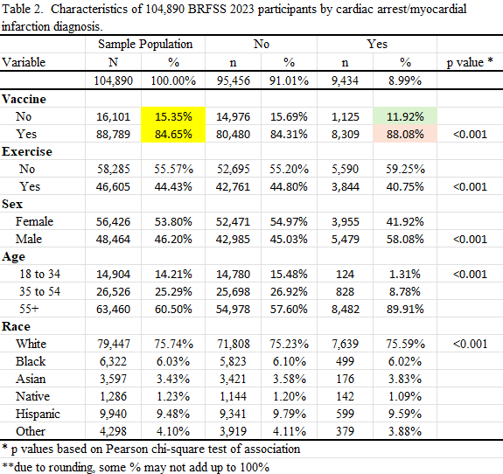
Contingency Table

Slide 8
HYPOTHESIS
The Null Hypothesis (H0)
  No association between Covid-19 vaccinations and a diagnosis of cardiac arrest/myocardial infarction in the US population.
Using a sample drawn from the BRFSS, this study determines:
  Whether there is enough evidence in the sample data to reject H0
  And, if so, the magnitude of the association.
That is,
  Given DIAGNOSIS = a + B1(VACCINE) + B2(EXERCISE) + B3(SEX) + B4(AGECAT) + B5(RACE)
    Is B1 statistically = 0?
    If not, how large is B1?

Slide 9
METHODS
Population of Interest
  Surveyed 18 to 80-year-old Americans across all 50 states that reported as to whether they had taken the COVID-19 vaccination or not.
Sample of Population
  CDC BRFSS 2023 survey
    Annually collects data on health-related risk behaviors, chronic health conditions, and use of preventative services from 400,000+ people.
  Of the 433,324 survey participants in 2023, 24.2% (104,890) satisfied the sample requirements for this study.
    Reported a COVID-19 vaccination status and had complete data for all variables.

Slide 10
METHODS
Model: DIAGNOSIS = f(VACCINE, EXERCISE, SEX, AGECAT, RACE)
  Outcome: Cardiac Arrest/Myocardial Infarction DIAGNOSIS (1 = Yes, 0 = No)
  Exposure: Covid-19 Vaccination VACCINE (1 = Yes, 0 = No)
  Controls:
    EXERCISE (1 = 300+ minutes/week, 0 = <300 minutes/week)
      After experiencing myocarditis from a vaccination sequence, those who exercise frequently may have a higher risk of cardiac arrest/myocardial infarction.
    SEX (1 = Male, 0 = Female)
      Males have been reported to experience myocarditis from a vaccination sequence more than females.
    AGECAT (1 = 18 to 34, 2 = 35 to 54, 3 = 55+)
      Younger population have been reported to experience myocarditis from a vaccination sequence more than the older population.
    RACE (1 = White, 2 = Black, 3 = Asian, 4 = Native, 5 = Hispanic, 6 = Other)
      Curiosity drove the choice of this variable.

Slide 11
METHODS
Statistical Approach
  Univariate statistics comparing actual with population expected distributions across variable sub-categories.
  Pearson X2 Test of Association
    Between the control variables (EXERCISE, SEX, AGE, RACE) and the exposure variable (VACCINE)
    Between RHS variables (VACCINE, EXERCISE, SEX, AGE, RACE) and the outcome variable (DIAGNOSIS)
  Logistic Regression => Adjusted Odds Ratios and 95% CI
    Additional analysis including:
      GOF Tests
      Confounding Tests
      Effect Modification Test/Estimation
  Findings presented in three report tables with discussion of each table’s results.
  Statistical analysis performed in SAS.

Slide 12
SUMMARY
The study aim is to advance our knowledge of the quantitative association between Covid-19 vaccinations and a diagnosis of cardiac arrest/myocardial infarction in the US population.
  Supported by a large, vetted, representative and current survey database of Americans health-related risk behaviors, chronic health conditions, and use of preventative services.
  A finding that Covid-19 vaccinated Americans are possibly at a higher risk of cardiac arrest/ myocardial infarction.
    More resources targeting the unforeseen effects of m-RNA vaccines.
    Increase the general awareness of the potential for myocarditis from Covid-19 vaccinations.

Slide 13
REFERENCES
CDC – 2023 Behavioral Risk Factor Surveillance System (BRFSS) Database
American Heart Association (AHA) 2025-Statistics-At-A-Glance
Nordic Cohort Study – Published in JAMA Cardiology (2022)
Israel Retrospective Study – Published in The New England Journal Of Medicine (2021)
US VAERS Analysis – Published in JAMA Cardiology (2022)
England Cohort Study – Published in Circulation (2022)
Global Vaccine Data Network (GVDN) Study – Published in Vaccine (2024)

Slide 14
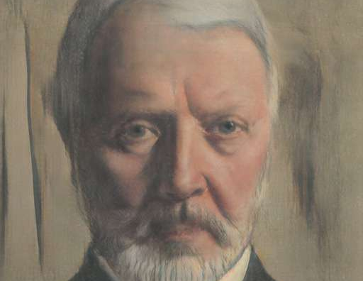
Thank you
Randall Crawford
901012194@student.nu.edu
March 27, 2025

